Slide 1
Transformer Review
黄天灵
VLSI Lab @ PKU Shenzhen
2023年5月23日

Slide 2
Contents
01 Transformer Networks
Attention Mechanism
02 Point Cloud Transformer Application
03 Transformers in 3D Point Clouds
Implementation
Operating scale
Global Transformers (PCT, Point-BERT) and Local Transformers (PT, Stratified Transformer)
Operating space
Point-wise: PT, PCT
Channel-wise: CAA
Data Representation
Voxel based: PVT
Point based
Uniform Scale: PCT, Point-BERT
Multi Scale: PT, Stratified Transformer
3D Tasks
Classification & Segmentation: PT, PCT, PVT

Slide 3
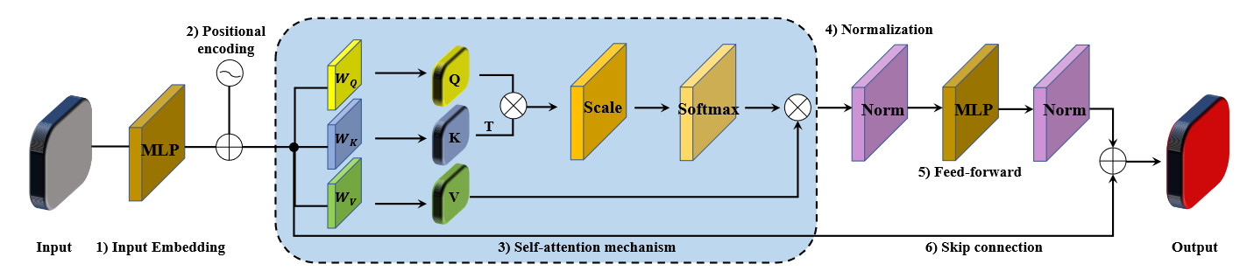
Attention Mechanism
Encoder
Input(word) embedding
Positional encoding
Self-attention
Normalization
Feed-forward operation
Skip connection
Decoder
Mirror the encoder
Input latent features from the encoder

Slide 4
Attention Mechanism
Encoder
Input(word) embedding
Positional encoding
Self-attention
Normalization
Feed-forward operation
Skip connection
Without positional encoding: Point Attention(P-A) and Attentional ShapeContextNet
Point Cloud Transformer(PCT): neighbor embedding( incorporate the positional encoding into the input embedding module)

Slide 5
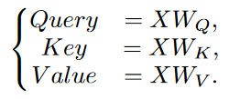
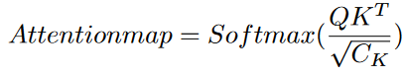
Attention Mechanism
Encoder
Input(word) embedding
Positional encoding
Self-attention
Normalization
Feed-forward operation
Skip connection
Notes:
2. 位置编码捕获几何信息或输入token的相对顺序，基于频率的位置编码可以使用sin或cos函数
3. 位置编码后，加入到feature map中，根据三个可以修改的权重矩阵WQ，WK，WV，feature map被投影到三个不同的特征空间。Query，Key，Value可以写成

Slide 6
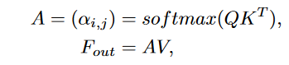
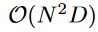
Attention Mechanism
Self-attention
Attention map of N×N : measures the similarity matrix
New feature map F: attention map × value
Easily learn global features
Advantage
Attention map depend on the input during inference
Self-attention mechanism is permutation-equivariant
Notes:
Transformer的attention权重图会随输入动态改变，相较于固定权重的MLP更具有适应性.
Self-attention具有置换同变性，而MLP的输入输出顺序编码在权重矩阵中

Slide 7
Attention Mechanism
Nomalization
Placed before and after the Feed-forward layer
LayerNormalization: same sample, different channel (NLP)
BatchNormalization: same channel, different sample (CV like 2D or 3D data processing)
Feed Forward
consists of two fully-connection layers with a RELU function
Notes:
归一化：放在前馈网络的前后两层
对于NLP主要用LayerNormalization，对于CV主要用BatchNormalizaition
LN和BN不同点是归一化的维度是互相垂直的，LN取的同一样本不同通道做归一化，BN取的是不同样本同一通道的特征做归一化。
前馈网络主要包括带有RELU函数的两个全连接层

Slide 8
Attention Mechanism
Skip-connection: between input and output of self-attention
Add shallow layer’s input In case the gradient disappears
Shallow features
high resolution
rich low-level information, which is more conducive to generating segmented masks
Notes:
Skip-connection放在self-attention模块的输入和输出之间
Skip-connection为了解决梯度消失的问题，深度神经网络参数学习通常是通过梯度下降的方法，从网络的输出层由后向输入层计算每一层的梯度，层数很多的时候梯度就会减小，无限接近于0，网络就无法更新学习了，于是为了解决：加上浅层的input，提供计算梯度的捷径
通过skip-connection可以把较浅的卷积层特征引过来，那些特征分辨率较高，且层数浅，会含有比较丰富的low-level信息，更利于生成分割mask。

Slide 9
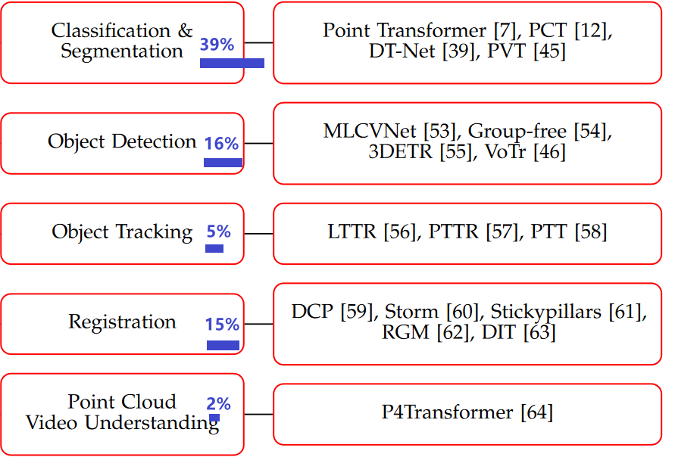
Point Cloud Transformer Application
Global Feature learning
Sequence independence
3D Transformer
Structure monitoring
Medical data analysis
Autonomous driving
Notes:
SA模块可以帮助transformer对序列的标记关系建模，这可以用在很多点云的处理应用中
点云Transformer的应用主要有五个领域
除了最经典的自然语言处理领域，Transformer的模型也被引入到图像处理领域（如图像分类的ViT），在很多领域表现的非常好，如图像分割，目标识别和追踪。
还有将卷积和Transformer结合的架构.
因为Transformer有很强的全局特征学习的能力和顺序无关的操作，很适合点云的处理和分析
因为分类和语义分割领域的应用最多，于是我最近主要在做这类的点云Transformer调研

Slide 10
Transformers in 3D Point Clouds
Implementation
Operating scale
Global Transformers (PCT, Point-BERT) and Local Transformers (PT, Stratified Transformer)
Operating space (calculate similarity)
Point-wise: PT, PCT
Channel-wise: CAA
Data Representation
Voxel based: PVT
Point based
Uniform Scale: PCT, Point-BERT
Multi Scale: PT, Stratified Transformer
3D Tasks
Classification & Segmentation: PT, PCT, PVT
Notes:
在3D点云中应用的Transformer可以分成几类，
操作尺度: 对于Transformer模块的部署区域，分为全局和局部的，全局Transformer将所有输入的点应用于全局特征的提取，局部transformer只将局部的标识应用在局部特征提取
操作空间: 分成了两类：逐点和逐通道的两种，分别在输入点和输入通道之间计算输相似度
在数据表示上，主要分成基于体素化和基于点的两种transformer。体素化有PVT，基于点的数据分为uniform scale 和 multi scale，表示点特征的规模在数据处理的时候是否变化。不变的有PCT，Point-BERT，变化的有PT，Stratified Transformer
在3D任务中占主要部分的是分类和语义分割，如Point Transformer， Point Cloud Transformer， PVT（Point-Voxel Transformer）

Slide 11
Transformers in 3D Point Clouds
Operating scale
Global Transformers (PCT, Point-BERT)
Local Transformers (PT, Stratified Transformer)
Notes:
全局：F中每个新的输出特征可以和输入特征X连接
局部：只会在局部的patch中完成特征的聚集，而不是在整个点云中

Slide 12
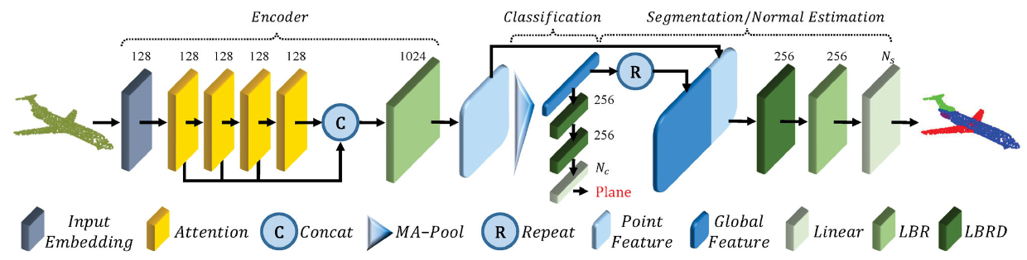
Global Transformers
Global context: New output feature in F connect with all input features X
PCT: pure global Transformer network
Taking the 3D coordinates as input P
Neighbor-embedding(map the point cloud into a high-dimensional feature space), incorporate local information into the embedded features
Features fed into 4 stacked global Transformer blocks to learn semantic information
Global features extracted by a global Max and Average(MA) pooling
Offset-Attention-> Laplacian matrix
M.-H. Guo, J.-X. Cai, Z.-N. Liu, T.-J. Mu, R. R. Martin, and S.-M. Hu, “PCT: Point cloud transformer,” Comput. Vis. Media., vol. 7, no. 2, pp. 187–199, 2021.
Notes:
LBR combines Linear, BatchNorm, and ReLU layers. LBRD means LBR followed by a Dropout layer.
优化 offset-attention 模块：提出的offset-attention模块方法是对原有的self-attention的有效升级。
工作原理是用self-attention模块的输入与attention特征之间的偏移量来代替attention特征。
attention图将以每一行的总和为 1 进行缩放，所以度矩阵可以被理解为单位矩阵。
offset-attention 优化过程可以近似理解为一个拉普拉斯过程。
优化attention权重，减少噪声影响
PCT是先为每个点计算了局部特征之后，在此基础之上计算全局特征，再将全局特征拼接到采样点的局部特征上进行使用。也就是说，先进行降采样计算局部特征，然后进行多轮的全局特征提取，并将每轮的提取结果进行拼接。

Slide 13
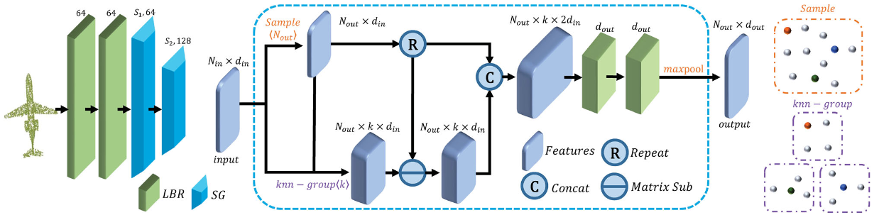
Global Transformers
PCT: pure global Transformer network
Neighbor-embedding Architecture (map the point cloud into a high-dimensional feature space), incorporate local information into the embedded features
LBR(Linear+BatchNorm+ReLU)+SG(Sampling and Grouping)
SG layer aggregates features from the local neighbors for each grouped by k-NN search using Euclidean distance during point cloud sampling
M.-H. Guo, J.-X. Cai, Z.-N. Liu, T.-J. Mu, R. R. Martin, and S.-M. Hu, “PCT: Point cloud transformer,” Comput. Vis. Media., vol. 7, no. 2, pp. 187–199, 2021.

Slide 14
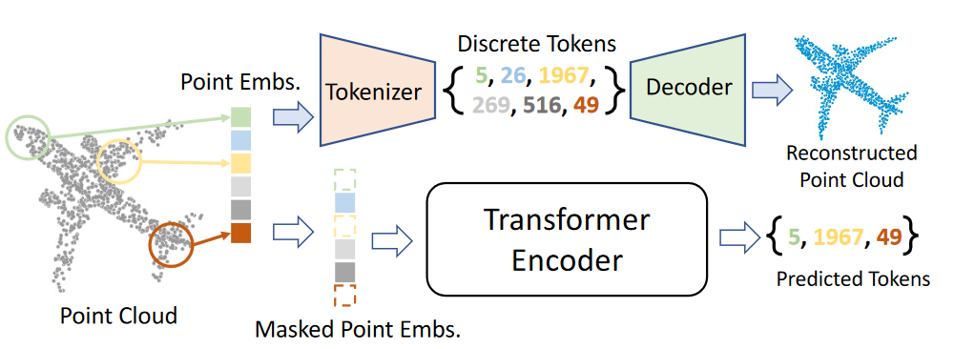
Global Transformers
Global context: New output feature in F connect with all input features X
BERT-style pre-training strategy for 3D global Transformers:
Adapt BERT to 3D point cloud processing
Taking the local patches as input, Input embedding(mini-PointNet), ViT, PC Tokenizer(convert the embedded points into discrete point tokens for pre-training)
During pre-training, the point embeddings with some masked tokens were fed into the Transformer encoder
the encoder can be trained to recover the corresponding tokens of the masked locations
X. Yu, L. Tang, Y. Rao, T. Huang, J. Zhou, and J. Lu, “Point-BERT: Pre-training 3D point cloud transformers with masked point modeling,” in Proc. IEEE Conf. Comput. Vis. Pattern Recognit., 2022, pp. 19 313–19 322.
Notes:
调研的另外一个全局Transformer是Point-BERT，它提出了一个用于3D全局Transformer预训练的策略
利用mini-PointNet进行输入嵌入，然后到ViT，利用点云Tokenizer来将嵌入的点转化成用于预训练的离散点token
预训练时，将部分离散的点加mask掩模，然后导入到编码器中
译码器根据加掩膜mask的点嵌入转化成预测的点标记
在tokenizer的支持下，模型被训练，恢复原始的点token
然后将预测的和实际的对比，得到训练效果

Slide 15
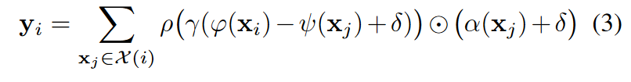
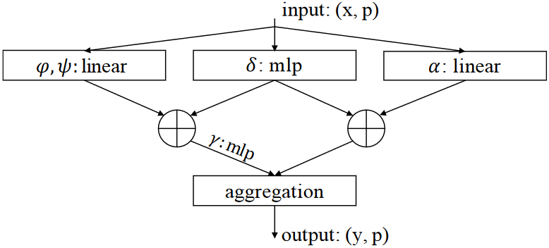
Local Transformers
Local context: achieve feature aggregation in the local patch instead of the entire point cloud
Point Transformer
Based on vector attention
yi is the output feature. φ, ψ, and α are pointwise feature transformations, such as linear projections or MLPs.
δ is a position encoding function and ρ is a normalization function such as softmax
attention vector γ (MLP+2linear+1ReLU nonlinearity)
the subset X (i) ⊆ X is a set of points in a local neighborhood (specifically, k nearest neighbors) of xi
H. Zhao, L. Jiang, J. Jia, P. H. Torr, and V. Koltun, “Point transformer,” in Proc. IEEE Int. Conf. Comput. Vis., 2021, pp. 16 25916 268.
Notes:
对于局部的Transformer，只会在局部的patch中完成特征的聚集，而不是整个点云中
yi is the output feature. φ, ψ, and α are pointwise feature transformations, such as linear projections or MLPs.
δ is a position encoding function and ρ is a normalization function such as softmax.
使用减法计算对应关系，在权重和value部分都加上了位置偏移编码（PCT主要用更改权重归一化的方式，使用offset-attention）

Slide 16
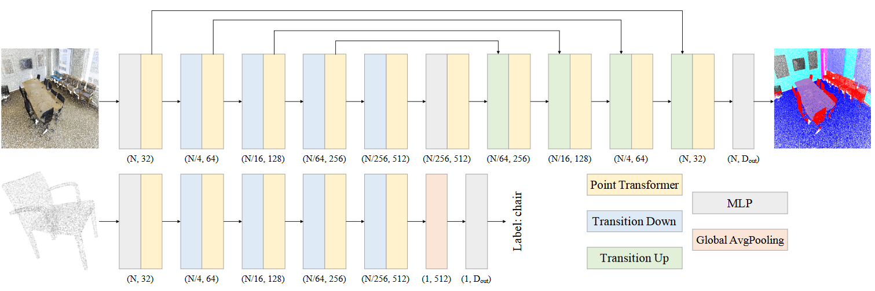
Local Transformers
Local context: achieve feature aggregation in the local patch instead of the entire point cloud
Point Transformer
Adopt the PointNet++ hierarchial architecture Focus on local patch processing
Replace the shared MLP modules in PointNet++ with local Transformer blocks
5 local Transformer blocks operated on progressively down sampled point sets( FPS )
transition down for feature encoding and transition up for feature decoding
transition down: pool feature vectors from P1 onto P2 (K-Nearest Neighbor, KNN) neighborhoods of sample points.
transition up: map features from the downsampled input point set P2 onto its superset P1 ⊃ P2
H. Zhao, L. Jiang, J. Jia, P. H. Torr, and V. Koltun, “Point transformer,” in Proc. IEEE Int. Conf. Comput. Vis., 2021, pp. 16 25916 268.
Notes:
采用PointNet++ 的分层架构对点云进行分类和切割，MLP被换成了局部Transformer模块
在每个下采样阶段，都使用transformer模块进行一次全局的特征提取。
PT一共有五级对点集进行降采样（最远点采样FPS）
（和将单一权重配置到整个特征向量相比，向量attention支持逐通道的attention权重配置）

Slide 17
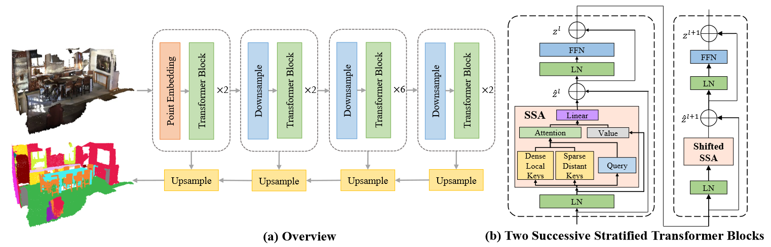
Local Transformers
Local context: achieve feature aggregation in the local patch instead of the entire point cloud
Stratified(分层) Transformer
Split the point cloud into a group of non-overlapping cubic windows via 3D voxelization
a KPConv embedding in the first stage to extract the local geometric information of the input point cloud.
Point Embedding to aggregate the features of local neighbors for each point
After several downsample layers and transformer blocks, the features are upsampled for segmentation.
X. Lai et al., “Stratified transformer for 3D point cloud segmentation,” in Proc. IEEE Conf. Comput. Vis. Pattern Recognit., 2022, pp. 8500–8509.
Notes:
首先通过3D体素化将点云分割成一组非交叠的立方窗口，在每个窗口执行局部transformer的操作。
在第一级执行一个KPConv嵌入来提取输入点云的局部几何信息
输入点云首先进入点嵌入模块来聚合局部结构信息，在几个下采样层和Transformer block之后，特征被上采样用于语义分割

Slide 18
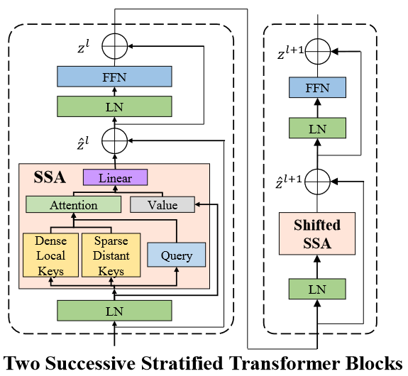
Local Transformers
Stratified Transformer
Encoder-decoder Architecture
Each stage has 2 successive Transformer blocks
The former block: a Stratified Self-Attention (SSA)
The latter block: Shifted SSA (shift the window by half of the window size between 2 successive Transformer blocks)
Facilitate cross-window communication
Each query point only needs to consider neighbors in the same window
Multi-head self-attention is performed in each window independently
X. Lai et al., “Stratified transformer for 3D point cloud segmentation,” in Proc. IEEE Conf. Comput. Vis. Pattern Recognit., 2022, pp. 8500–8509.
Notes:
Stratified 分层Transformer是一个编码解码结构，编码器包含多级，每级有两个连续的Transformer模块，前一个模块采用分层Self-attention(SSA)来捕获
不像全局的Self-attention，每个query点只需要考虑相同窗口的邻居，在每个窗口独立执行多头自注意力

Slide 19
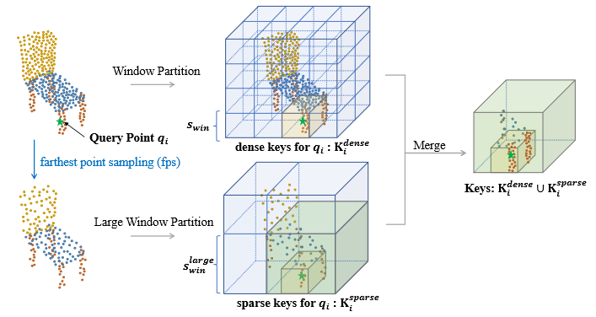
Local Transformers
Effective receptive field is enlarged remarkably and the query feature is able to effectively aggregate long-range contexts
Stratified Strategy for sampling keys
Partitioned into non-overlapping cubic windows with the window size swin
For each query point qi, we find the points Kdense i in its window
Downsample the input points through farthest point sampling (fps)
Find the points Ksparse i with a larger window size slarge win
both dense and sparse keys form the final keys, i.e., Ki = Kdense i ∪ Ksparse i
X. Lai et al., “Stratified transformer for 3D point cloud segmentation,” in Proc. IEEE Conf. Comput. Vis. Pattern Recognit., 2022, pp. 8500–8509.
Notes:
具体来看一下Stratified Key采样的策略
感受野：特征图上的某个点能看到的输入图像的区域

Slide 20
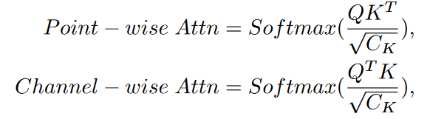
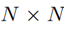
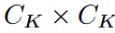
Transformers in 3D Point Clouds
Operating space
Point-wise: PT, PCT
measure the similarity among input points
Channel-wise: CAA
distribute attention weights along channels
Notes:
逐点：计算输入点的相似度
逐通道：逐通道Ck(key 的通道)分配attention权重

Slide 21
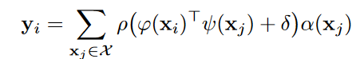
Point-wise Transformers
Point Transformer
φ, ψ, and α are pointwise feature transformations, such as linear projections or MLP
δ is a position encoding function and ρ is a normalization function such as softmax
The scalar attention layer computes the scalar product between features transformed by φ and ψ
use the output as an attention weight for aggregating features transformed by α.
H. Zhao, L. Jiang, J. Jia, P. H. Torr, and V. Koltun, “Point transformer,” in Proc. IEEE Int. Conf. Comput. Vis., 2021, pp. 16 25916 268.
Notes:
线性投影或MLP过程

Slide 22
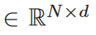
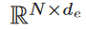
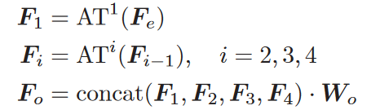
Point-wise Transformers
PCT: pure global Transformer network
Taking the 3D coordinates as input P
de-dimensional embedded feature Fe
Neighbor-embedding
embedd the input points into a new feature space
M.-H. Guo, J.-X. Cai, Z.-N. Liu, T.-J. Mu, R. R. Martin, and S.-M. Hu, “PCT: Point cloud transformer,” Comput. Vis. Media., vol. 7, no. 2, pp. 187–199, 2021.
Notes:
点云P共有N个点，每个都含有d个维度的特征描述
嵌入的特征有de个维度，首先通过Input Embedding进行学习
最后通过将每个attention层的输出连接起来，形成do维的特征表述Fo（Wo是线性层的权重）

Slide 23
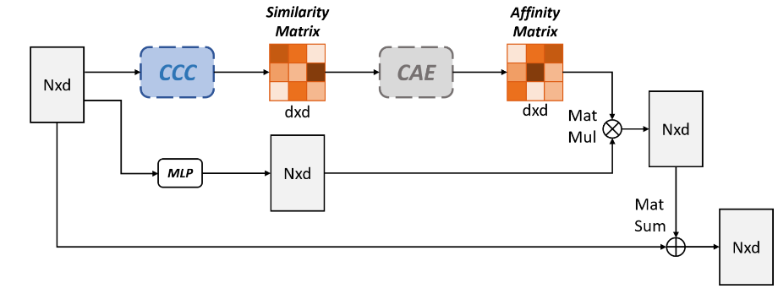
Channel-wise Transformers
CAA: Channel-wise Affinity Attention module for better feature representations
Compact Channel-wise Comparator (CCC) block
generate the similarity matrix in the channel space
Channel Affinity Estimator (CAE) block
calculated an affinity matrix( higher attention value --- lower similarity of the two channels )
Sharpen the attention weights and avoid aggregating similar/redundant information
Each channel of the output feature had sufficient intersection with other distinct ones ( proven to be beneficial to the final results )
S. Qiu, S. Anwar, and N. Barnes, “Geometric back-projection network for point cloud classification,” IEEE Trans. Multimedia, vol. 24, pp. 1943–1955, 2022.
Notes:
逐通道匹配attention模块
CAA包含两个模块：
紧凑逐通道比较器模块：CCC在通道空间生成相似度矩阵
通道匹配预测模块：CAE进而计算一个匹配度矩阵，注意力越高代表两个通道的相似度越低
这个操作可以提高注意力权重，避免聚集相似或冗余的信息，这样每个输出特征的通道都和较远点有足够的交互，被证明对最终结果有好处

Slide 24
Transformers in 3D Point Clouds
Data Representation-different input formats
Voxel based: VoTr
3D point clouds are generally unstructured, and cannot be directly processed by traditional convolution operators.
but be easily converted into 3D voxels, which are structured like images.
Rasterize(栅格化) onto a regular grid and 3D Conv
Geometric information loss in fine grained
Point based
Accurate point position but maintain high computational consumption
Uniform Scale: PCT, Point-BERT
Multi Scale: PT, Stratified Transformer
Notes:
3D点云一般都是非结构化的，杂乱无章，不能直接被传统卷积操作处理。然而却可以很容易地转化成3D体素，像图片一样结构化。
体素化的模型一般将点云栅格化到规则网络上，然后利用3D卷积用于特征学习，这些模型有高能效的计算能力，但是在细粒度精度上不可避免的有信息损失
而基于点的模型虽然可以保持点位置的准确性，但是通常计算密集
分为规模不变型和多规模型（如前面提到的PT）

Slide 25
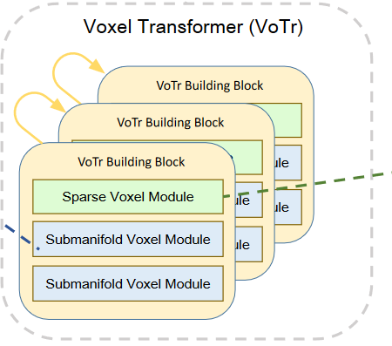
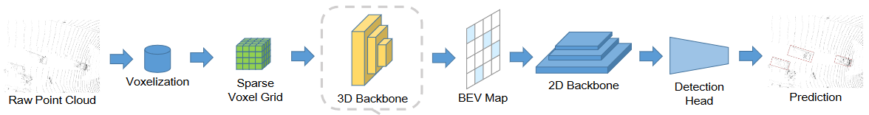
Voxel-based Transformers
VoTr: Voxel Transformer backbone for 3D object detection
Submanifold(子流形) Voxel module
extract features from non-empty voxels( perform multi-head self-attention strictly )
Sparse(稀疏) Voxel module
extract features from empty voxels
J. Mao et al., “Voxel transformer for 3D object detection,” in Proc. IEEE Int. Conf. Comput. Vis., 2021, pp. 3164–3173.
Notes:
有文章提出基于体素的用于3D目标识别的Transformer-VoTr
对于子流形体素化模块，从非空的体素中提取特征（执行多头注意力机制）
稀疏体素化模块从空的体素中提取特征
Local Attention focuses on the neighboring region to preserve detailed information.
Dilated Attention obtains a large attention range with only a few attending voxels。

Slide 26
Point-based Transformers
transformation to voxels would lead to geometric information loss
Uniform Scale ( keep the scale of the point features constant )
PCT
After the input embedding stage, four global Transformer blocks of PCT were directly stacked together to refine point features.
no hierarchical (分层) feature aggregation operation
Facilitate the decoder design for dense prediction tasks like point cloud segmentation
Feeding all input points into the Transformer block is beneficial to global feature learning
But weak in extracting the local features due to the lack of local neighborhoods.
Processing the whole point cloud directly would lead to a high computation footprint and memory consumption
M.-H. Guo, J.-X. Cai, Z.-N. Liu, T.-J. Mu, R. R. Martin, and S.-M. Hu, “PCT: Point cloud transformer,” Comput. Vis. Media., vol. 7, no. 2, pp. 187–199, 2021.
Notes:
Uniform-scale architectures usually keep the scale of the point features constant during data processing. The number of output features of each module is consistent with the number of input features.
Hierarchical 分层的
Facilitate 促进

Slide 27
Point-based Transformers
Multi Scale ( progressive point sampling strategies during feature extraction )
PT (pioneering design that introduced the multi-scale structure to a pure Transformer network)
The Transformer layers in PT were applied to progressively (sub)sampled point sets.
Accelerate the computation of the whole network by reducing the parameters of the Transformer
Beneficial to the tasks that need fine semantic perception(segmentation and completion)
For classification, perform global average pooling over the pointwise features to get a global feature vector for the whole point set
H. Zhao, L. Jiang, J. Jia, P. H. Torr, and V. Koltun, “Point transformer,” in Proc. IEEE Int. Conf. Comput. Vis., 2021, pp. 16 25916 268.
Notes:
连续点采样
开创性的将多维度结构引入到纯Transformer网络中，可以应用在连续下采样点集中（减少点集的基数）
采样点可以减少参数来加速计算
对细粒度的语义感知有好处
最后在逐点的特征上采用了一个全局平均池化来获得整个点集的全局特征向量用于分类任务

Slide 28
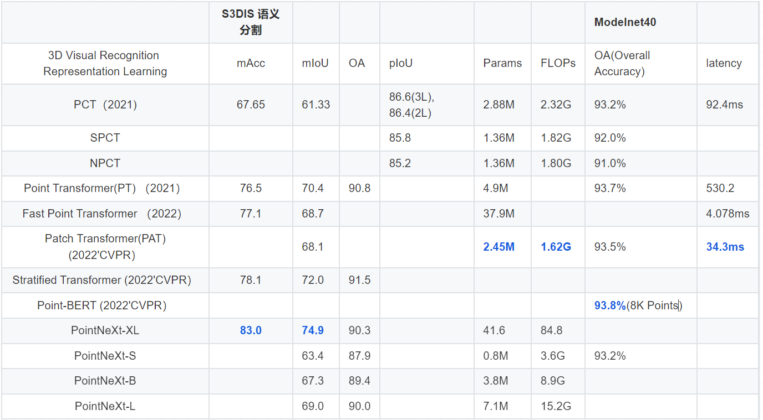
Point Cloud Transformer
Notes:
我总结了一下各个点云Transformer的性能，在S3DIS语义分割数据集的准确率和平均交并比mIoU参数上，PointNeXt和 Stratified Transformer的表现最好，在Modelnet40数据集中，Point-BERT的准确率最高，而Patch Transformer的参数量和需要的算力最低，在保证较高性能的基础上延迟最低。
我们可以具体来看一下高能效Patch Transformer

Slide 29
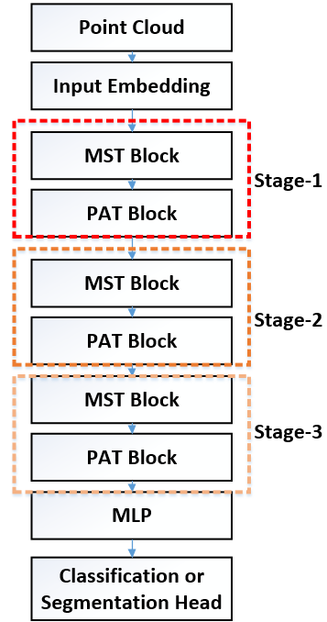
Efficient Transformers-PatchFormer
Reduce the size of the attention map
first split the raw point cloud into M patches, followed by aggregating the local feature in each patch to generate Key matrix
Computational cost of the self-attention in PatchFormer can be reduced to O(NM)
Z. Cheng, H. Wan, X. Shen, and Z. Wu, “Patchformer: A versatile 3D transformer based on patch attention,” arXiv:2111.00207, 2021

Slide 30
PatchFormer
N Points
MST(Multi Scale Attention)Block
Voxelize point cloud into voxel grids
Aggregate multi-scale features
Conducts 3D window-based SA(W-SA) to capture local information
Transform voxel grids to points
3x3x3, 5x5x5, 7x7x7
3x3x3, 5x5x5
3x3x3, 5x5x5
Z. Cheng, H. Wan, X. Shen, and Z. Wu, “Patchformer: A versatile 3D transformer based on patch attention,” arXiv:2111.00207, 2021
Notes:
首先，我们的MST block将点云转化成体素栅格，然后将结果导入到多尺度聚合模块.
利用不重叠的3D窗口的self-attention来捕获局部信息
最后再将体素栅格转化为点

Slide 31
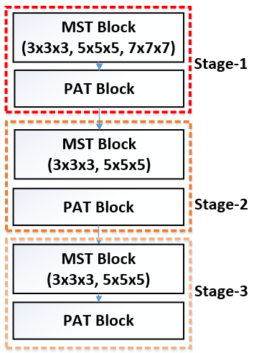
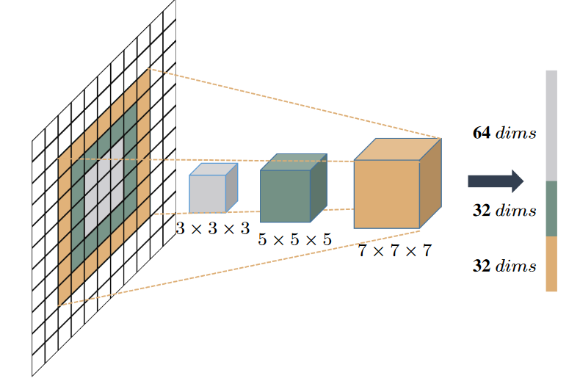
PatchFormer
MST Block-stage1
Multi-scale Feature Aggregating
Sample boxes using three DWConv kernels of different size
Concatenate grids as one embedding
Receive voxel grids as input, sample boxes using 3 kernels of different size
Z. Cheng, H. Wan, X. Shen, and Z. Wu, “Patchformer: A versatile 3D transformer based on patch attention,” arXiv:2111.00207, 2021
Notes:
DWConv Deep-Width Convolution 深度-宽度 卷积
以第一层为例，我们收到体素栅格作为输入，用三个不同大小的卷积核采样，三个栅格会被投影并且连接为一个嵌入
三个卷积核，大kernel用小维度，小kernel用大维度（比5x5x5大的kernel会使用3x3x3和5x5x5的kernel堆叠卷积而成），步长1x1x1
和维度一致的卷积相比，这种方法可以在保持模型的高性能基础上减少计算复杂度。
其他几级的MST block也以相似的方式工作

Slide 32
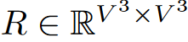
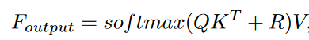
PatchFormer
MST Block
Attention Building
Limit the SA computation to non-overlapping local 3D windows
Advantageous to include relative position bias in SA computation
Introduce 3D relative position bias
Z. Cheng, H. Wan, X. Shen, and Z. Wu, “Patchformer: A versatile 3D transformer based on patch attention,” arXiv:2111.00207, 2021
Notes:
标准的self-attention的计算复杂度和特征图的尺寸成平方关系，文章为了解决这个缺陷，MST block将self-attention计算限制在不重叠的局部3D窗口
另外，大量文章表明，在self-attention的计算中包含相关位置偏置很有优势，于是
引入3D相关的位置偏置R，定义局部3D窗口的体素栅格数量为V三方，R在V三方 × V三方的一个空间内，
在我们的网络中，局部attention建立在多维度输入特征中，因此我们不需要为了跨窗口连接和更大感受野来堆叠更多的attention层

Slide 33
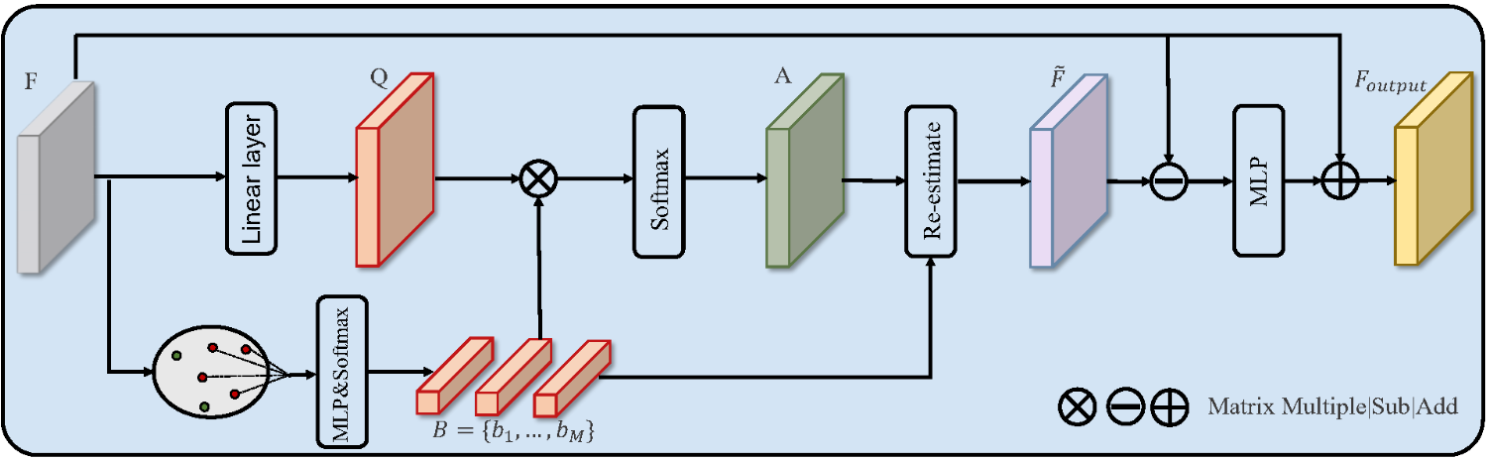
PatchFormer
N Points
M Patches
(M << N )
Base Estimation
PAT block
Base estimation
use the K-Means algorithm to segment P into M patches
Aggregate global feature using patch attention at a lower computational cost
adjust the contribution of all points in the same patch to the base via a data-driven way
Z. Cheng, H. Wan, X. Shen, and Z. Wu, “Patchformer: A versatile 3D transformer based on patch attention,” arXiv:2111.00207, 2021
Notes:
PAT模块在接收到MST的输出后，利用K-Means最近邻的方法，将点云P的数量从N个分成M个patch
分割一个压缩的base，基于这个base产生全局的attention map
在自己的queries和一个更小的数据集中计算，捕获点云的全局文本；
Base预测可以通过数据驱动，调整相同patch里面每个点的贡献

Slide 34
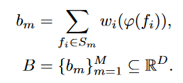
PatchFormer
N Points
M Patches
(M << N )
Base Estimation
Bm: aggregating the representations of all the points in the Sm
fi is the representation of point pi
φ(·) is an MLP with one linear layer and one ReLU nonlinearity
wi is the normalized degree for fi belonging to the Sm
Z. Cheng, H. Wan, X. Shen, and Z. Wu, “Patchformer: A versatile 3D transformer based on patch attention,” arXiv:2111.00207, 2021
Notes:
通过聚集Sm中的每个代表点，定义为base bm
fi是点pi的代表

Slide 35
PatchFormer
N Points
M Patches
(M << N )
Base Estimation
base estimation: adaptively adjust the contribution of all points in the same patch to the base via a data-driven way.
Such adaptive adjusting facilitates to fit the intrinsic geometry submanifold.
Z. Cheng, H. Wan, X. Shen, and Z. Wu, “Patchformer: A versatile 3D transformer based on patch attention,” arXiv:2111.00207, 2021
Notes:
通过数据驱动的方式，自适应调整同一patch中所有点的分布
这种自适应调整有利于拟合本征几何子流形。

Slide 36
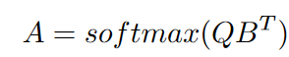
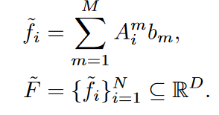
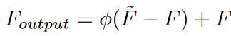
PatchFormer
N Points
D Dimention
Data Re-estimation
Attention map A are used to re-estimate the inputs F
Z. Cheng, H. Wan, X. Shen, and Z. Wu, “Patchformer: A versatile 3D transformer based on patch attention,” arXiv:2111.00207, 2021
Notes:
在Data Re-estimation部分
转换函数是一个有linear layer的MLP和一个ReLU非线性的激活函数。
MLP和ReLU计算完B后，替换K矩阵，重新用softmax函数计算出attention map A。
B集合和attention map A 重新计算输入F
计算预测的特征F‘和输入特征F之间的差值传入MLP层，这个MLP层中有一个线性层和一个非线性ReLU
PAT找到了一个替代点云的数据集，减少了复杂度，只需要计算一次K-Means算法

Slide 37
Ref
H. Zhao, L. Jiang, J. Jia, P. H. Torr, and V. Koltun, “Point transformer,” in Proc. IEEE Int. Conf. Comput. Vis., 2021, pp. 16 25916 268.
M.-H. Guo, J.-X. Cai, Z.-N. Liu, T.-J. Mu, R. R. Martin, and S.-M. Hu, “PCT: Point cloud transformer,” Comput. Vis. Media., vol. 7, no. 2, pp. 187–199, 2021.
X. Yu, L. Tang, Y. Rao, T. Huang, J. Zhou, and J. Lu, “Point-BERT: Pre-training 3D point cloud transformers with masked point modeling,” in Proc. IEEE Conf. Comput. Vis. Pattern Recognit., 2022, pp. 19 313–19 322.
S. Qiu, S. Anwar, and N. Barnes, “Geometric back-projection network for point cloud classification,” IEEE Trans. Multimedia, vol. 24, pp. 1943–1955, 2022.
J. Mao et al., “Voxel transformer for 3D object detection,” in Proc. IEEE Int. Conf. Comput. Vis., 2021, pp. 3164–3173.
X. Lai et al., “Stratified transformer for 3D point cloud segmentation,” in Proc. IEEE Conf. Comput. Vis. Pattern Recognit., 2022, pp. 8500–8509.
Z. Cheng, H. Wan, X. Shen, and Z. Wu, “Patchformer: A versatile 3D transformer based on patch attention,” arXiv:2111.00207, 2021. [Online]. Available: http://arxiv.org/abs/2111.00207

Slide 38
Thank you!
Tianling Huang
School of Electronic and Computer Engineering
Peking University Shenzhen Graduate School
Shenzhen, China

